Slide 1
Battle of the Neighborhoods
Melbourne, Australia

Slide 2
Background
This presentation is the result of a capstone project for the IBM Data Science Professional Certificate.
Foursquare location data was used to explore neighborhoods in Melbourne in order to solve a problem.

Slide 3
PROBLEM STATEMENT
Melbourne is the food capital of Australia. There is an immense variety of restaurants and opportunity for a business owner if they find the right location.
This project answered the question "Where is the best location for a licensed restaurant in Melbourne?".
It is a project of direct interest and benefits to new restaurateurs in Melbourne.

Slide 4
Data Sources
Two main data sources were used to locate the coordinates of Melbourne suburbs and venues. Namely:
- ’Corra.com.au’, for latitude and longitude coordinates for Melbourne suburbs
- the Foursquare API for venues data

Slide 5
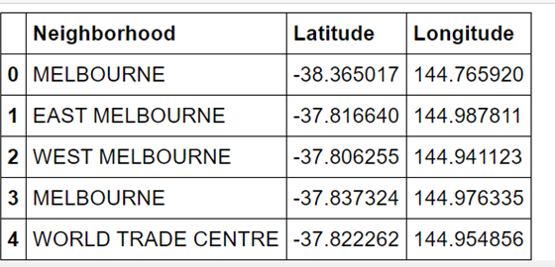
Data Description
Once formatted into a data frame, the data looked as follows:

Slide 6
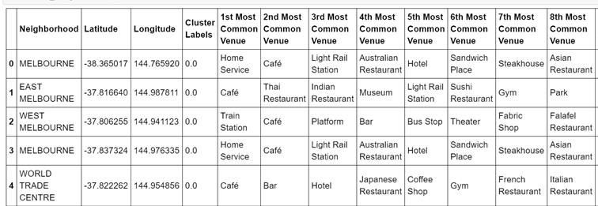
Most Common Venues

Slide 7
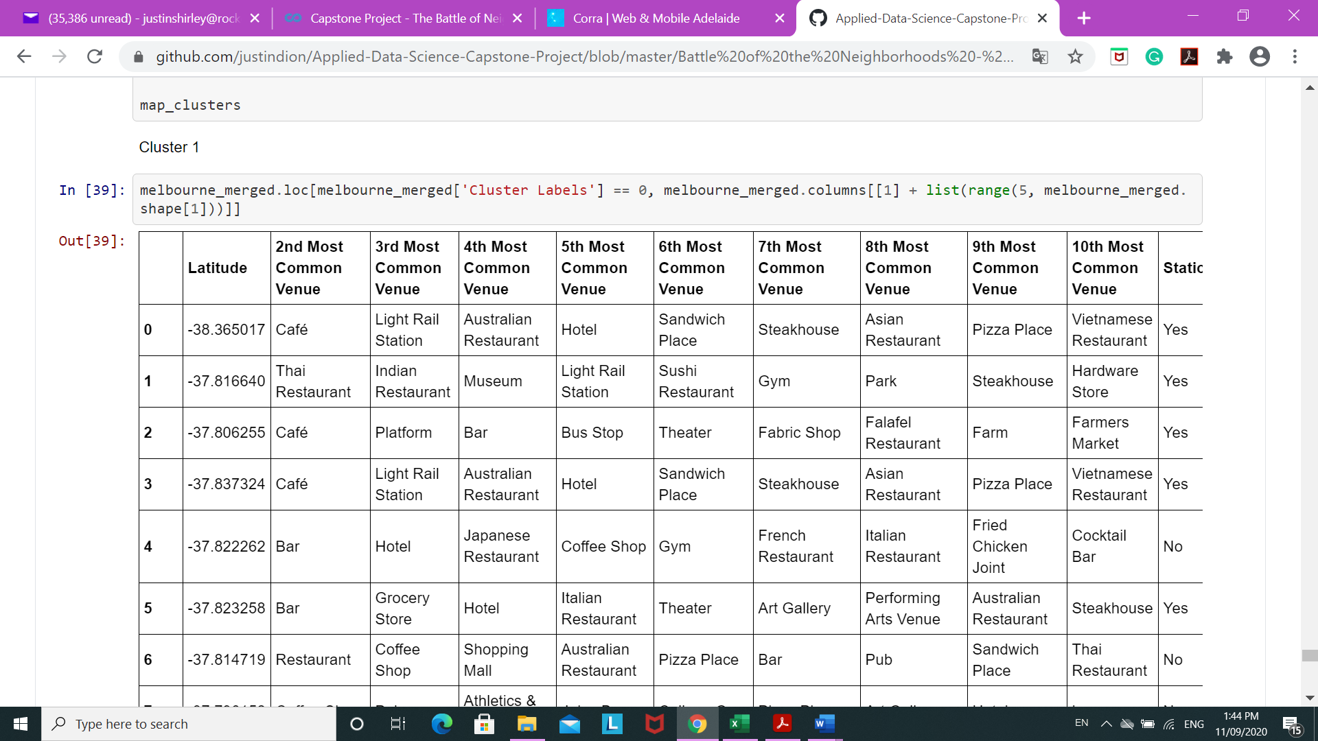
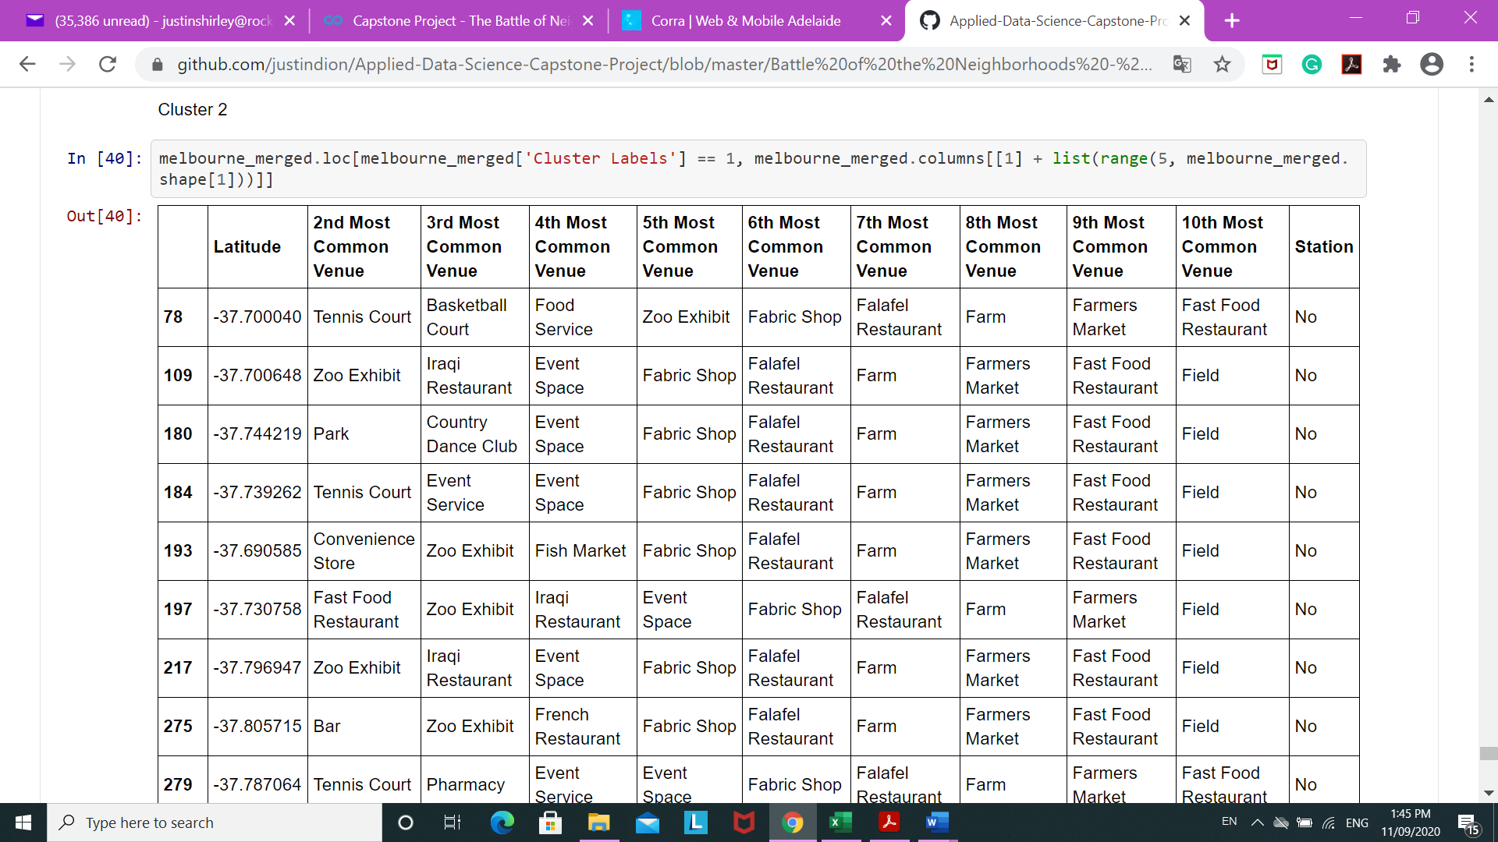



Results
Cluster 1
Cluster 2
Cluster 3
Cluster 4
Cluster 5

Slide 8
Recommendation
Cluster 1 has a nice mix of cafes, restaurants and pubs.
Cluster 2 is largely characterised by tourist locations.
Cluster 3has a predominance of parks.
Cluster 4 is strongly related to the presence of pubs.
Cluster 5 is a mix of tourism and camping grounds.
Given the question we are traying to answer is a licensed restaurant. Cluster 4 seems the most applicable cluster to concentrate on.

Slide 9
Conclusion
To conclude, neighborhoods data was collected and formatted. Venues data using Foursquare was also obtained.
The resulting clusters indicated a preference for cluster 4 and given the amount of licencsed premised and the problem statement centering on the best location for a licenced premises in Melbourne.

Slide 10
THANK YOU!!

